Slide 1














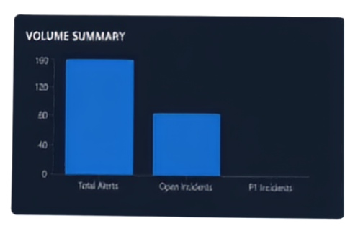



Infinity
Threat Platform
Security Operations Centre
Infinity:
Dashboard
TOTAL ALERTS
OPEN INCIDENTS
P1 INCIDENTS
FP RATE
FALSE POSITIVES
GENUINE THREATS
159
86
0
46.5%
40
1
Alert Feed
Threat Intelligence Correlation &
Incidents
MITRE ATT&CK
CLASSIFICATION BREAKDOWN
VOLUME SUMMARY
Commander View
Alert Prioritisation Assistant
RECENT INCIDENTS
Empowering Defence Analysts and Commanders with Evidence-Driven Insights
Title
Severity
Classification
Agreement
Score
Regional Alert Cluster — Vessel-Noise-6287 [for...
LOW
✔ FALSE POSITIVE
✔ NOT ANALYSED
30.0
Regional Alert Cluster — Vessel-Noise-5125 [for...
LOW
✔ FALSE POSITIVE
✔ NOT ANALYSED
24.8
+
+
+
+
+
+
+
+
+
+
+
+
Powered by IBM Bob
19 September 2026

Slide 2



OPERATIONAL PROBLEM
& STAKES
Thousands of alerts flood in from diverse sources every day
Analysts face overload across formats and systems
Real threats can be missed with catastrophic consequences
False positives drain time and critical resources
Commanders need a clear BLUF threat assessment within minutes

Slide 3















WHY CURRENT ALERT HANDLING FAILS
Inconsistent formats require manual normalization
Duplicate alerts lead to wasted analyst time
False positives demand manual filtering
MANUAL ALERT WORKFLOW
Related alerts not grouped, investigated in isolation
Manual workflows slow analysts down, create risk, and delay critical decisions.
Mapping and risk assessment are inconsistent and slow
Reporting takes time, delays command decisions

Slide 4












INFINITY
SOLUTION OVERVIEW
INGEST & NORMALISE
Consolidate multi-source alerts and remove duplicates automatically
FOCUS ON REAL THREATS
Filter false positives to cut noise and reduce analyst workload
PRIORITISED
MULTI-SOURCE ALERT FEEDS
NORMALISE & DUPLICATE
FILTER FALSE POSITIVES
ROADWIDE MITRA ATTACK
IBM BOB AI REASONING
BLUF
CORRELATE & SCORE
Link related alerts into incidents with risk and confidence scoring
SUMMARIES
UNDERSTAND & PRIORITISE
Map behaviour to MITRE ATT&CK and generate BLUF summaries
AI-POWERED REASONING
Use IBM Bob AI for evidence-backed analysis and recommendations

Slide 5



WORKFLOW
COMPARISON
WITHOUT INFINITY
WITH INFINITY
Receiving alerts
Checking formats
Removing duplicates
False positive checks
Manual grouping
Investigating
MITRE mapping
Risk assessment
Report writing
Commander delivery
Multi-source ingestation
Normalization/deduplication
False positive filtering
Correlation
Scoring
MITRE mapping
IBM Bob AI reasoning
BLUF summary
Defence analyst & commander
MANY MANUAL STEPS → ONE INTELLIGENT WORKFLOW
Analysts spend less time processing alerts and more time investigating real threats.

Slide 6

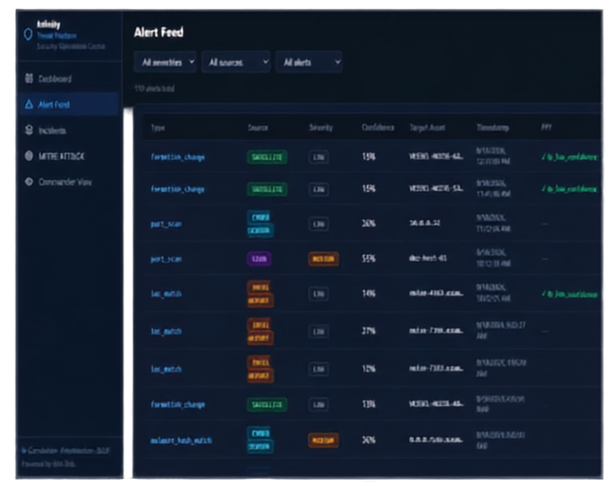


MULTI-SOURCE INGESTION &
NORMALISATION
One pipeline. Many sources. Clearer, cleaner intelligence.
Ingest alerts simultaneously from SIEM, Cyber Sensors, Satellites, and Intelligence Reports
Automatically normalises diverse formats into a unified structure
Duplicates alerts to remove redundancies and noise
Reduces manual format checks and duplicate handling

Slide 7

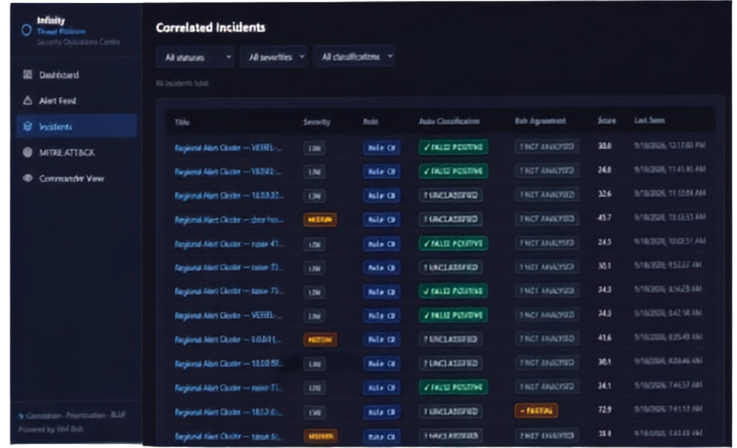

CORRELATION,
FALSE POSITIVE FILTERING &
PRIORITISATION
Reduce noise, surface what matters.
Infinity filters out false positives with 46.5% false positive rate reduction.
Correlates related alerts into consolidated incidents for efficient investigation.
Scores incidents by severity and confidence to prioritise analyst focus.
Save time. Cut through noise. Focus on real threats.

Slide 8



MITRE ATT&CK
Mapping and Evidence-backed Reasoning
Maps incidents to MITRE ATT&CK
tactics, techniques, and sub-techniques automatically
Provides structured attacker behaviour
context for analysts
IBM Bob AI applies evidence-backed reasoning
to refine incident understanding and confidence
Accelerates investigations with
greater accuracy and confidence

Slide 9

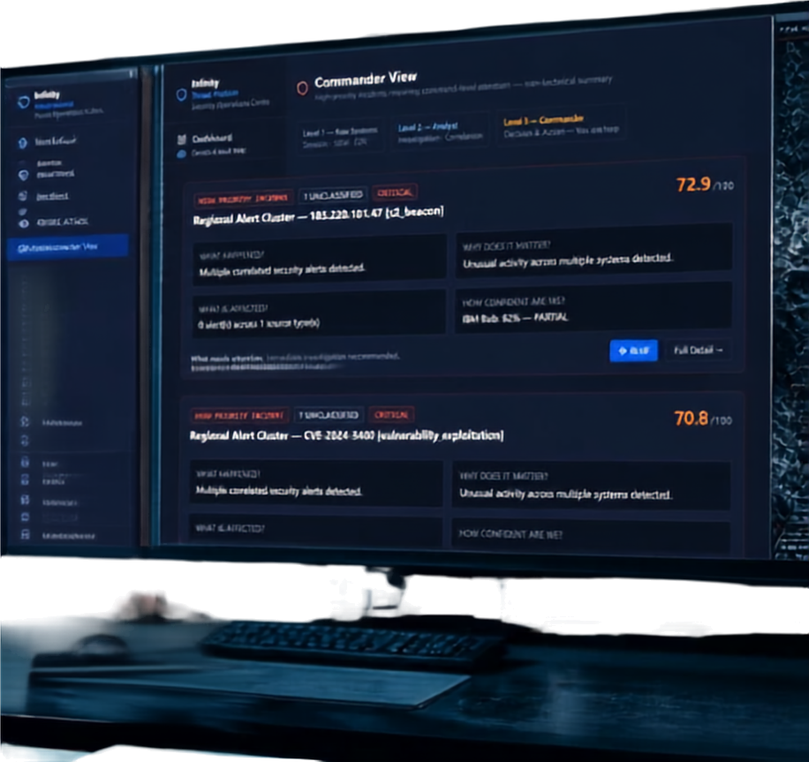

COMMANDER VIEW &
BLUF OUTPUTS
High-priority incidents in one decisive view
What happened, why it matters and affected assets
Confidence scores and recommended actions
Structured intelligence, delivered for rapid decisions

Slide 10












END-TO-END IMPACT &
KEY BENEFITS
Compresses many manual steps into one intelligent, evidence-driven workflow
Infinity transforms threat intelligence from data overload to actionable insight.
Analysts spend less time on alert processing and more on investigating genuine threats
Commanders receive clear, prioritised BLUF summaries within minutes
Improved threat detection reduces the risk of missed genuine threats
Thank you.
We welcome your questions and next steps.
Increases operational efficiency and optimises resource allocation

